Slide 1
Zarilda
A 58 page report – what I know and how I know it

Slide 2
The Report
“The Parents of Zarilda McMichael McClellan Marquart” 58 pages
Sections:
  [Introduction]
  What We Know
  McMichael
  Hardin County
  Family Documents etc.
Includes
  Maps
  Images of records and documents
  Pictures
  Transcripts
  Analysis

Slide 3
Suggestions
Prepare an outline of the document for ready reference
Use this – or create a table of contents – with clickable links to take you to the section or page as you work.
Consider creating and incorporating a chronology of events. Perhaps parallel chronologies for different family groups
Edit for clarity and conciseness.
Consider writing up some elements for publication
Cite your sources – footnotes or endnotes

Slide 4
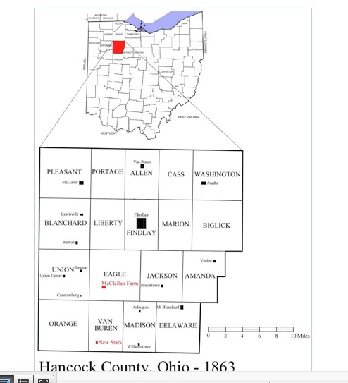
Locate the location.
Find township map..

Slide 5
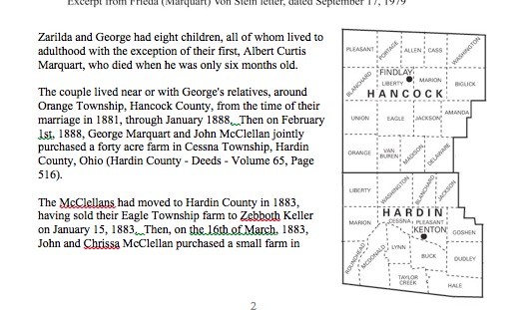
Show place relationships
çv
çv

Slide 6
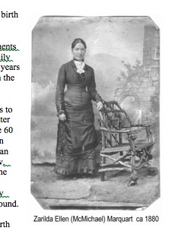
Portraits make it personal.

Slide 7
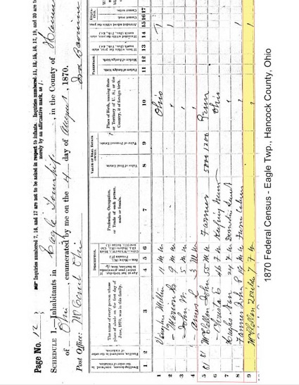
Include image of originals in your working notes.

Slide 8
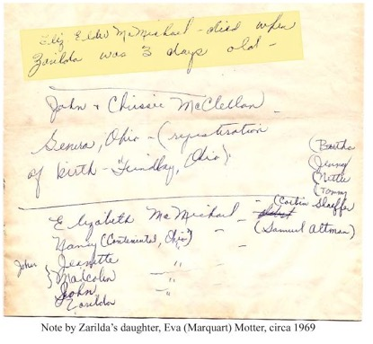
… including family documents.

Slide 9
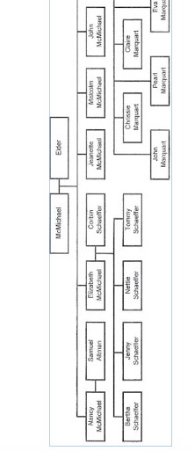
Charts help

Slide 10
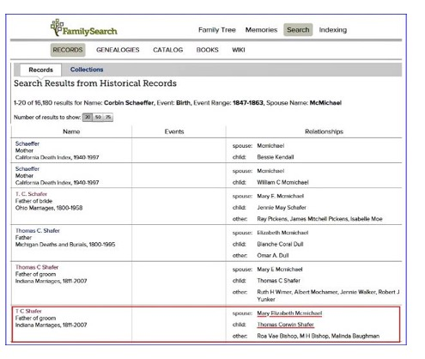
Describe and show search strategies and results.

Slide 11
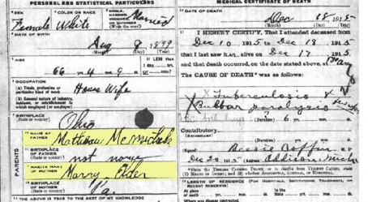
Highlight relevant information.

Slide 12
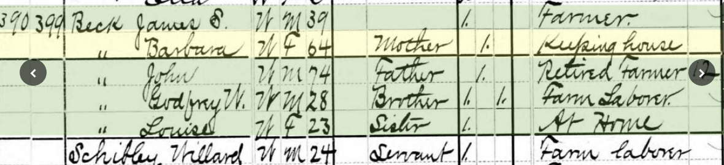
Beck Household in 1880,
Scio Twp. Washtenaw County
Barbara (Volz) Beck, 64 and her husband Johhn Beck, 74, a retired farmer
live with their son John Beck. Also in the hh are 2 other ch. Godfrey & Louise
The 1880 census does not
document land ownership.

Slide 13
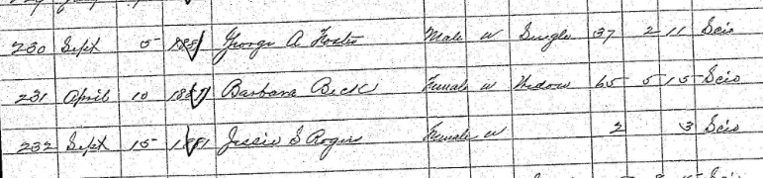
Barbara Beck of Scio Twp.,
Washtenaw Co., dies 10 April 1891 age 65-5-15
Note she is “Widowed”

Slide 14
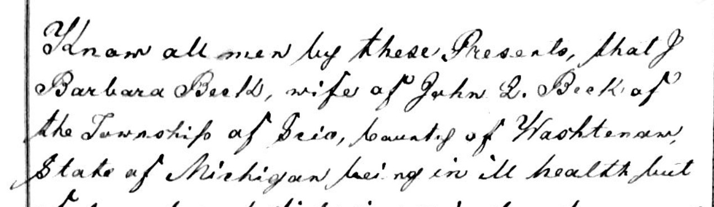
Will of Barbara Beck, wife of John L. Beck, of Scio Twp., Washtenaw Couny
Admitted to Probate June 6, 1881

Slide 15
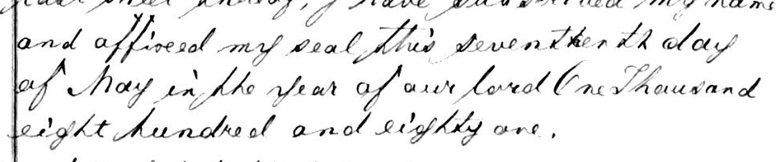
The will admitted was written
8 May 1881

Slide 16
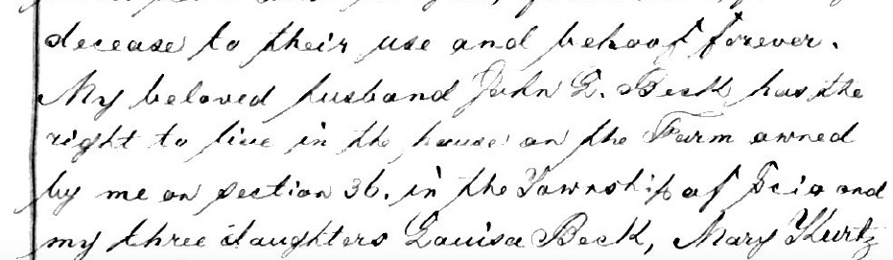
In it she provides for the care and maintance of her “beloved husband John
Property is left to two daughters, who are charged
with housing and taking care of John throughout his life

Slide 17
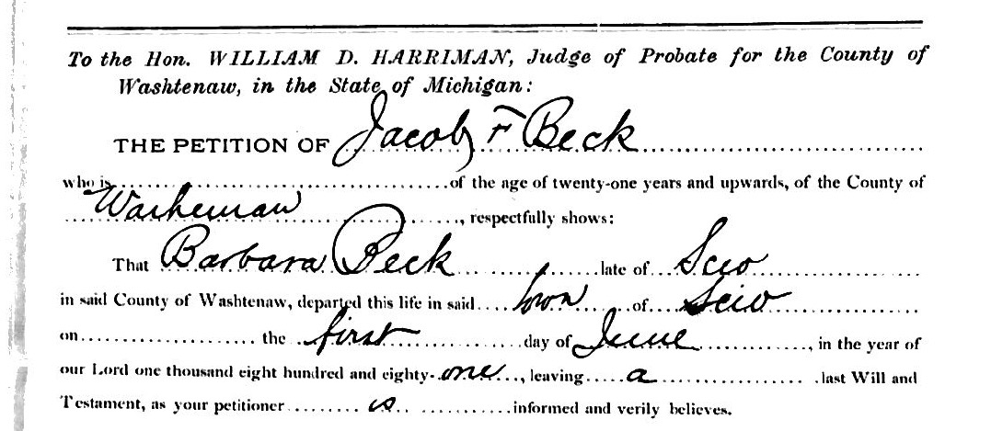
The petition for probate says she died 1 June 1881

Slide 18
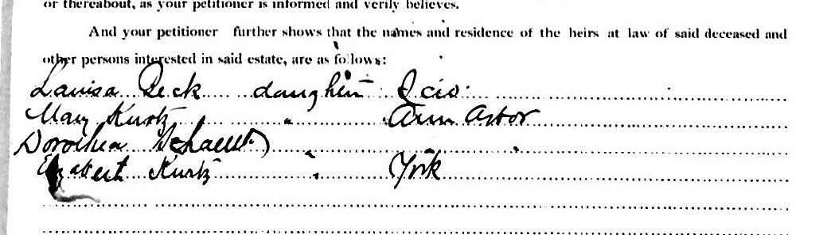
Husband not named on list of heirs—what does that mean?
She had several more children These are
those who inherited through provision in the
will. But what if she died without a will?

Slide 19
Research Question: one person or two?
Was Barbara on the death record as dying at Scio Twp. on 10 April 1881 the same Barbara, wife of John L. Beck, her will on May 17, 1881 and died 1 June 1881 according to the will petition?

Slide 20
What do we know?
There was a fairly large Beck family living in Washtenaw Co. They appear to have been related and some lived in Scio Twp.
No adult Barbara Beck identified 1850-1880 other than the wife of John.
German names sometimes went by first, sometimes by middle.
No death record for a Barbara Beck d. 1 June 1881
We do not know when John Beck died.
  And found no probate for John Beck (?)
  He is not listed as being buried in the same cemetery.

Slide 21
What background information do we know?
Death information is submitted once a year; accuracy depends on the doctor’s records.
  Mistakes would be understandable. (2 of them?)
Michigan passed the first Married Women’s Property Act in 1844.
  Barbara could have owned that land in her own name throughout the past several decades –even before 1844

Slide 22
Census summary of John L. Beck
1850 Lodi Twp. married, ch, farmer, $2300
  Agricultural schedule is under John Beck
1860 Scio Twp. married, ch, $8000
  Agricultural schedule is under John Beck
1870 Scio Twp., married, ch., $7,500 (sons also have property valued at $7,500)
  Agricultural schedule is under John Beck
1880 Agricultural Schedule is under Barbara Beck, not John Beck; census doesn’t ask about property holdings.

Slide 23
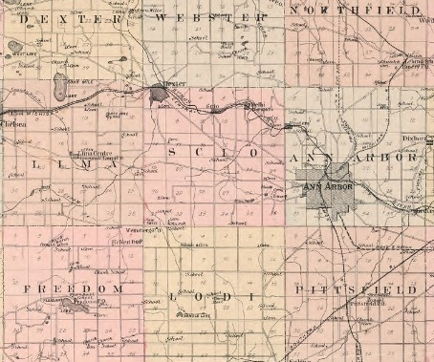
Check newspapers for April and June of 1881? Which newspapers?
Village
of
Dexter
Is in Scio
Twp.

Slide 24
Other?
Sort out Scio (and other) Beck families to see if any female of the right age to be the Barbara who d. April 1881
Check cemetery records to see if a Beck female with a different name died April 10.
See if any probate records for a Beck man mentioned a wife Barbara (she d. a widow)

Slide 25
Can we resolve the conflicting information?
Rule:
A determination regarding a fact or event, requires confidence that even if new information is discovered, it will not negate your conclusion.
If all the prior work comes back negative, how sure are we that there is not a 2nd Barbara Beck, who was a widow when she May, 1881 and the death record simply contains mistaken information?

